Slide 1
Go
Getting Started With Golang

Slide 2
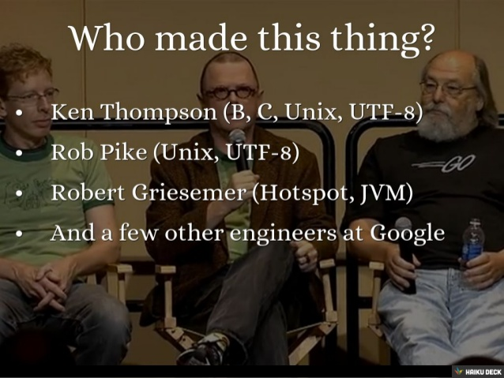
Go was invented by geniuses

Slide 3
Unless you speak “genius”
Go can be hard-er-ish to learn
from the docs.
Go was invented by geniuses

Slide 4
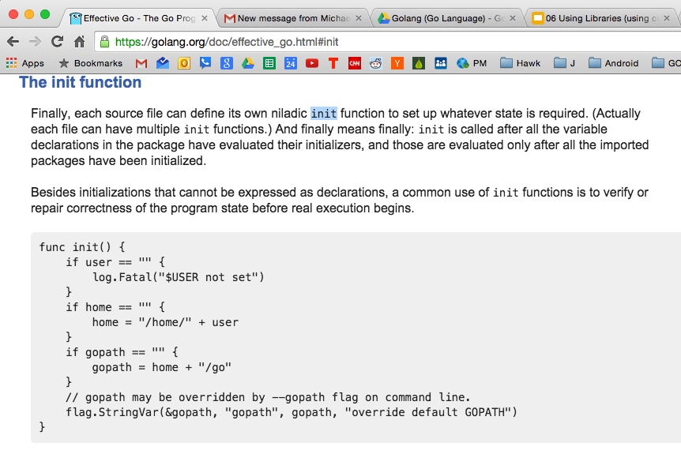
Unless you speak “genius”
Go can be hard-er-ish to learn from the docs.

Slide 5

learning go from the docs ...

Slide 6
“Go is a very well documented programming language but this documentation can be difficult to understand unless you are already familiar with programming languages.”
~ Caleb Doxsey

Slide 7

learning go in this course

Slide 8
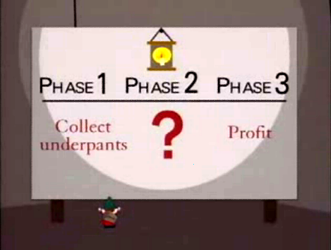
My goal is to make it easy to learn Go.
I want to provide “Tony Gaddis” quality learning materials for Go.
I want Go to become a popular, widespread language.
Notes:
Go merits becoming a widespread language.

Slide 9
install
https://golang.org/doc/install

Slide 10
download
https://golang.org/dl/

Slide 11
SHA1 checksum
https://support.apple.com/en-us/HT201259

Slide 12
at terminal:
openssl sha1 [full path to file]

Slide 13
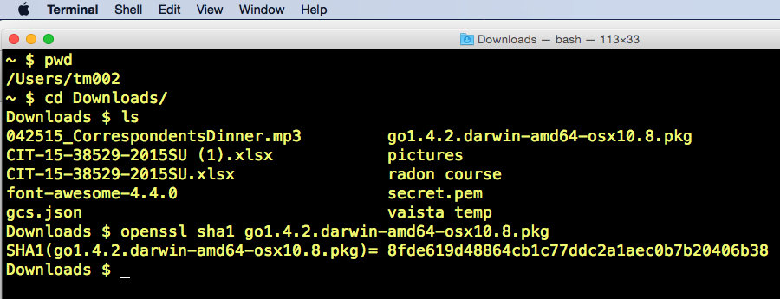

Slide 14
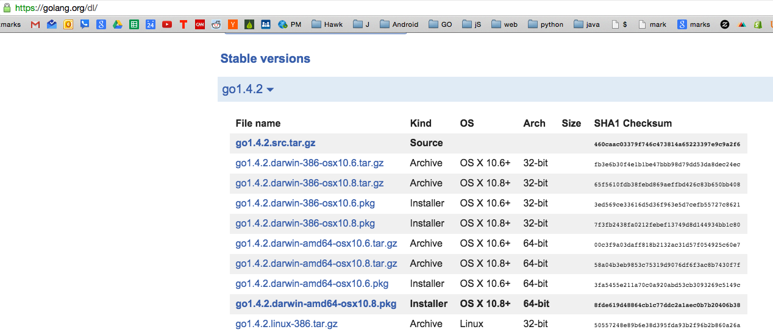

Slide 15
test install
go version

Slide 16
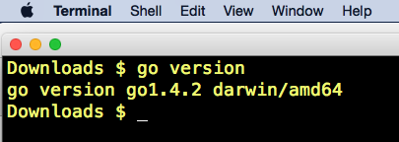

Slide 17
“go” commands
https://golang.org/cmd/go/

Slide 18
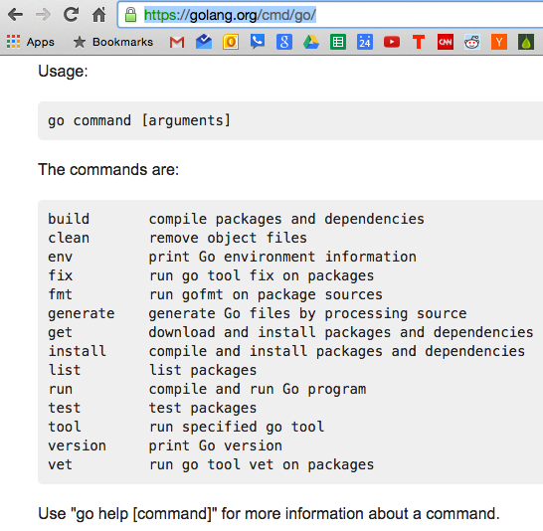

Slide 19
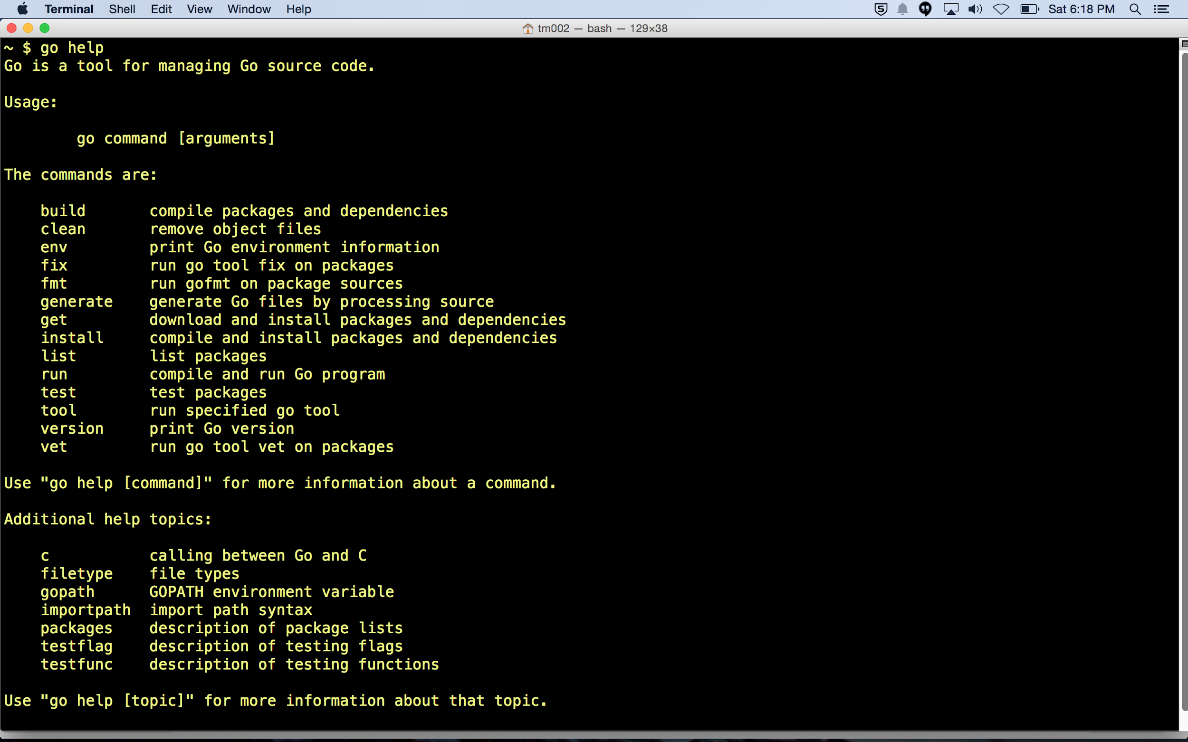

Slide 21
exercise
try running “go help” at terminal

Slide 22
exercise
try running “go env” at terminal

Slide 23
workspace
go is opinionated

Slide 24
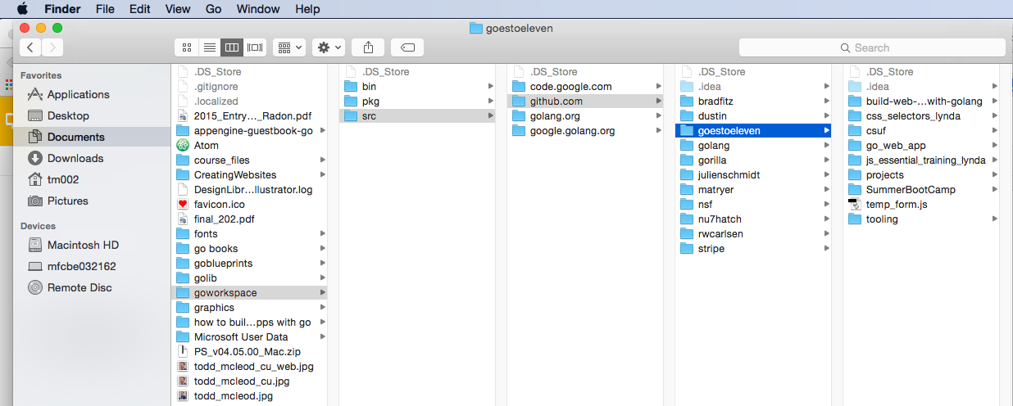
call this folder whatever you like; mine will be called “go” for the rest of this course, however, maybe not the best name as this is also the name of the folder holding the go program

Slide 25
path variables

Slide 26
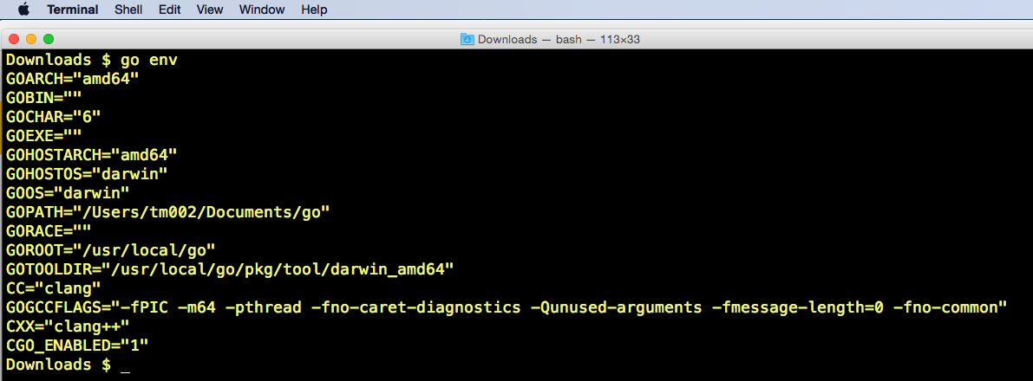

Slide 27
GOPATH
must point to your workspace

Slide 28
GOROOT
must point to golang source code

Slide 29
How To Set GOPATH

Slide 30
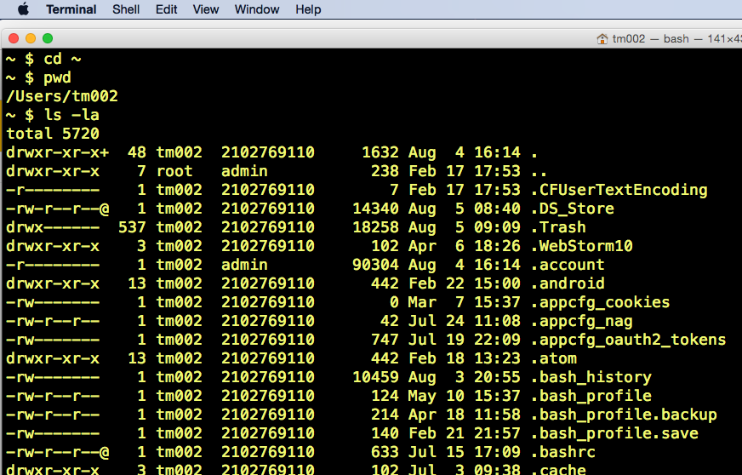

Slide 31
at terminal
nano .bash_profile

Slide 32
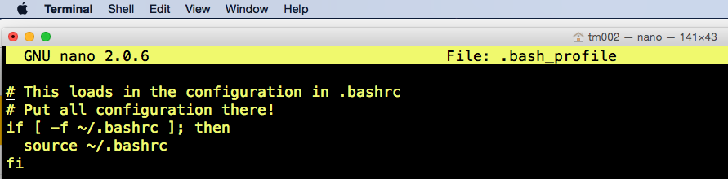

Slide 33
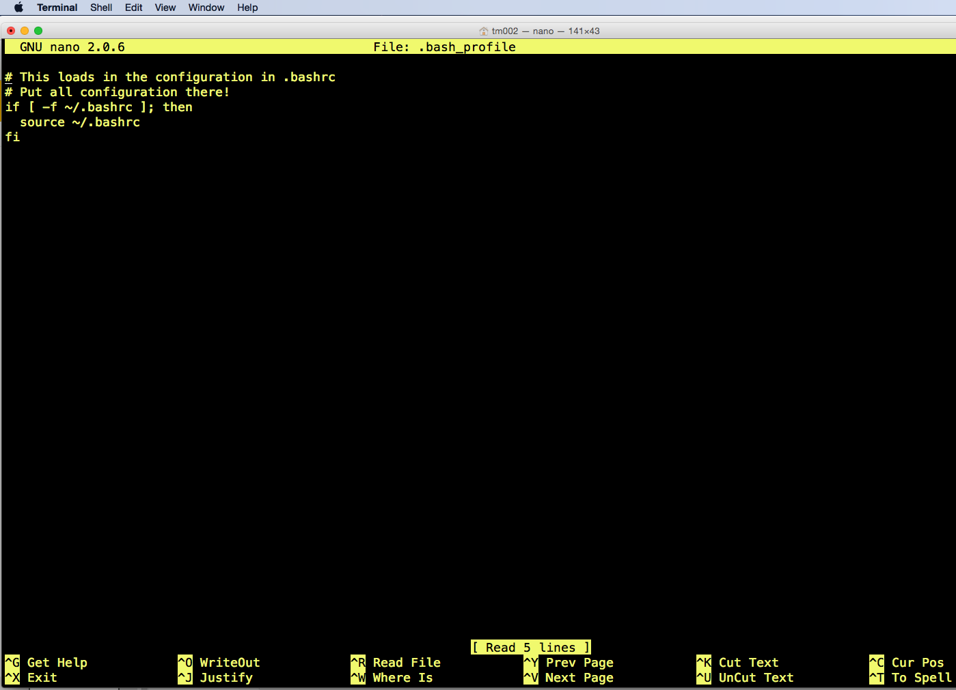

Slide 34
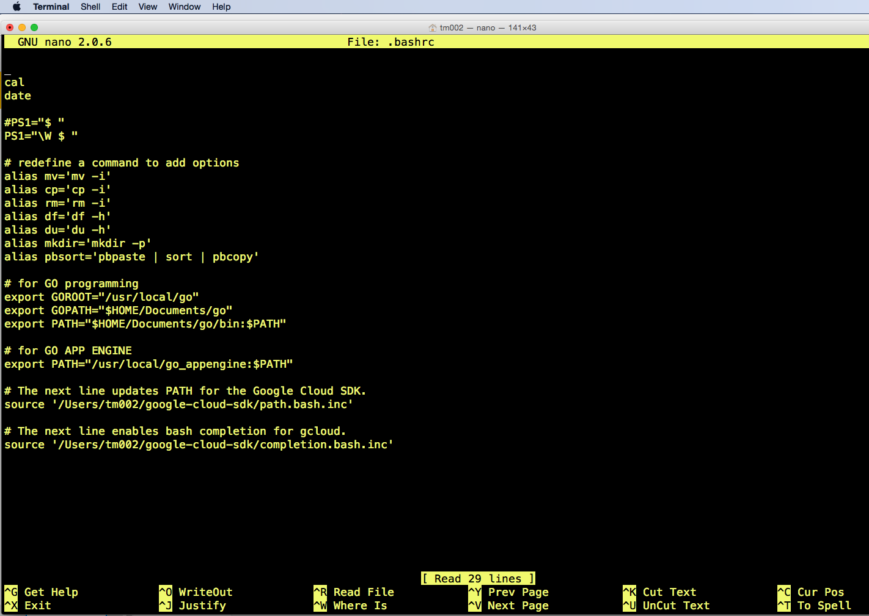

Slide 35
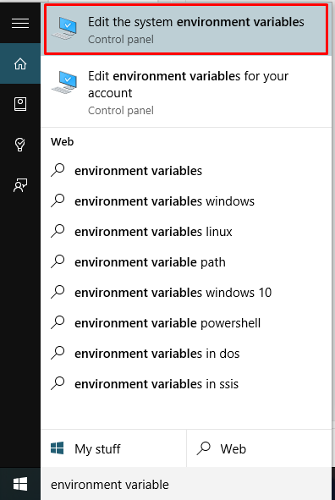

Slide 36
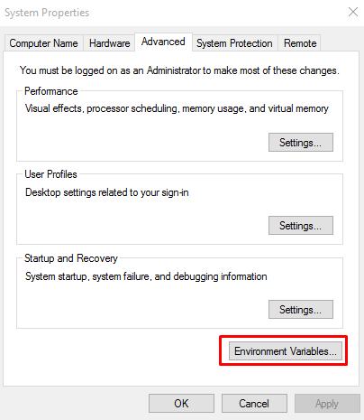

Slide 37
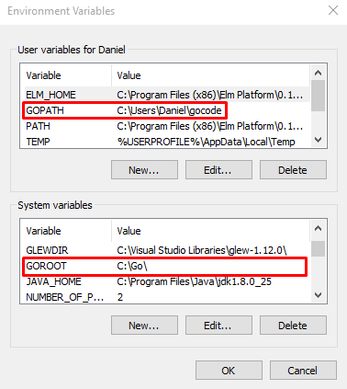

Slide 38
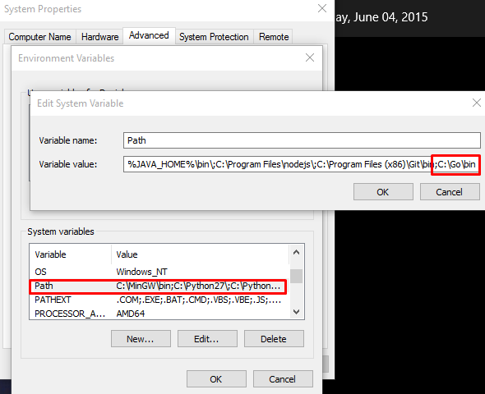

Slide 39
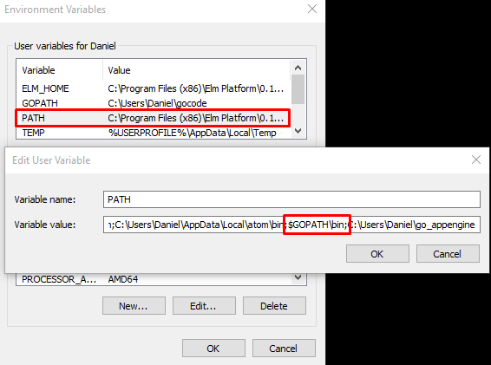

Slide 40
repos
workspace organized for vcs

Slide 41
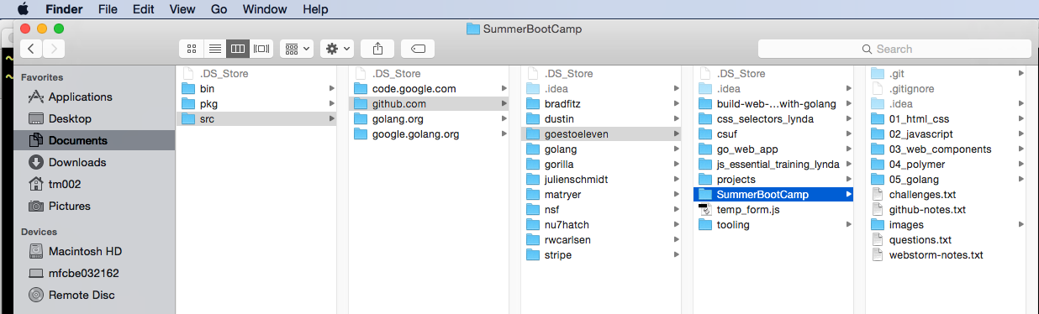

Slide 42
Review
Geniuses: Rob Pike, Ken Thompson, Robert Griesemer
SHA1 checksum
openssl sha1 [full path to file]
go version
go env
go commands
https://golang.org/cmd/go/
go help
workspaces
path variables
aka environment variables
GOPATH
GOROOT
.bash_profile
.bashrc
repos & workspace

Slide 43
Review Questions

Slide 44
SHA1
What is SHA1, how is it used, and how can it tell you if you have received the file that a sender intended?

Slide 45
go version
What does go version do?

Slide 46
go env
What does go env do?

Slide 47
Path Variables
What are path variables?
What are path variables also sometimes called?

Slide 48
GO ROOT
What is GO ROOT and where should it point?

Slide 49
GO PATH
What is GO PATH and where should it point?

Slide 50
Go Workspace
What should be the file structure of your go workspace?

